Slide 1



WISHING YOU A SAFE AND HAPPY CHRISTMAS

Slide 2
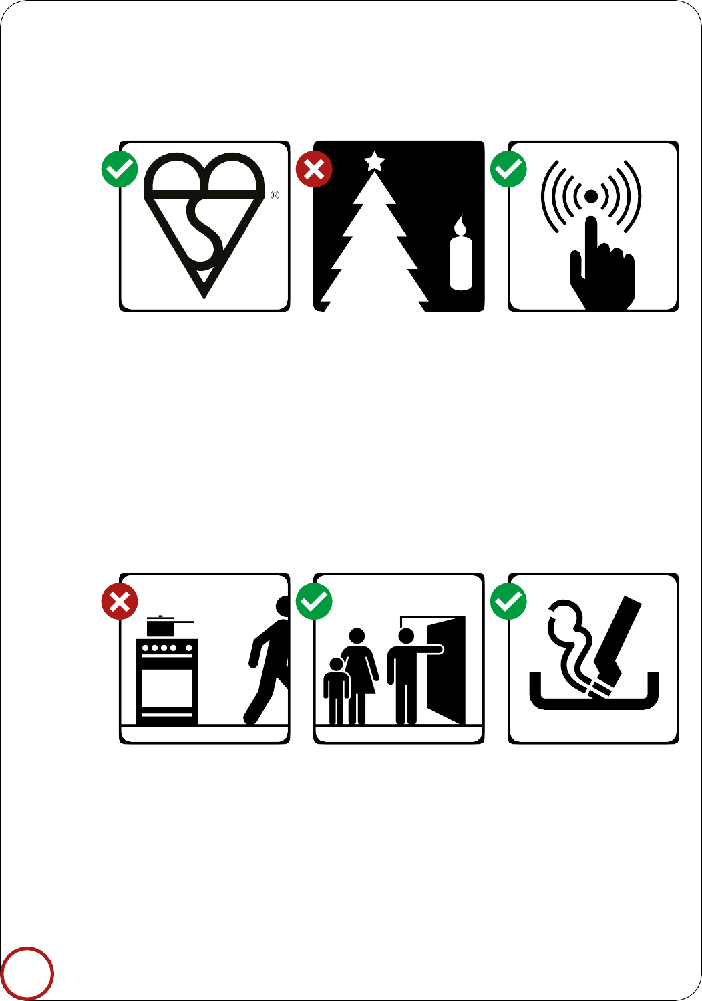
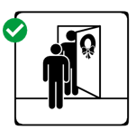
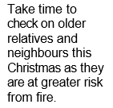
Check your Christmas tree lights carry the British Safety Standard sign.
Never place candles near your Christmas tree or materials that can catch light easily.
Most fires start in the kitchen. Avoid leaving a cooker unattended.
Avoid cooking when under the influence of alcohol.
Make sure your family and visitors know how to escape in an emergency.
Make sure cigarettes are put out properly.
2

Slide 3
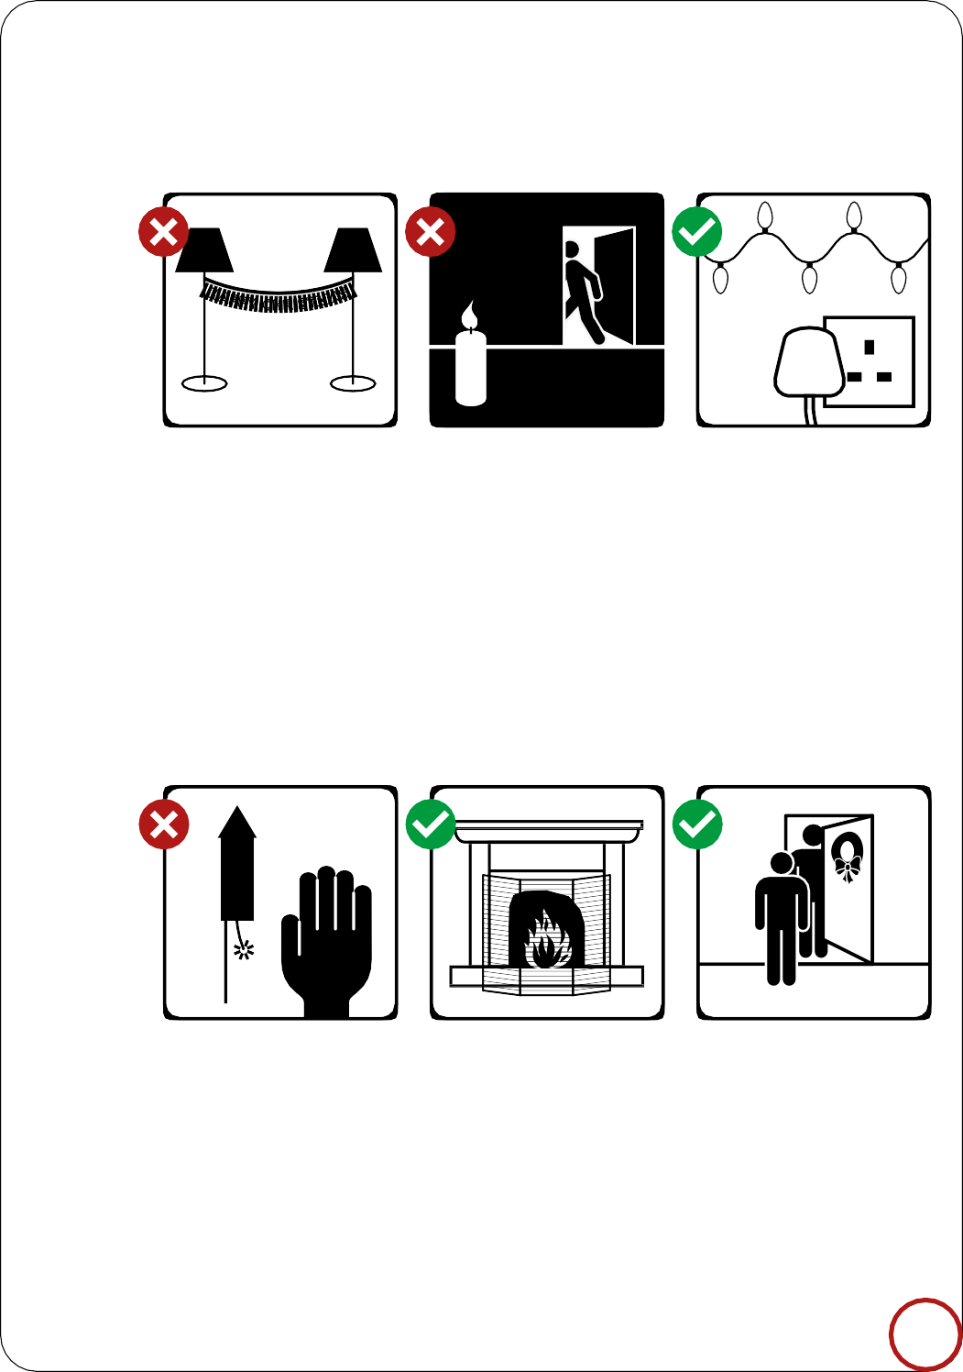

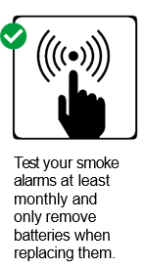
H
A
P
P
Y
H
S
T
M
A
S
C
I
R
Decorations can burn easily – so don’t attach them to lights or heaters.
Keep candles, lighters and matches out of children’s reach. Never leave burning candles unattended.
Never overload electrical sockets. Always switch Christmas lights off and unplug them before
you go to bed.
Take time to check on older relatives and neighbours this Christmas as they are at greater risk from fire.
3

